Slide 1


Question of the day
Water is the only substance found on earth naturally in three forms.
Correct?

Slide 2
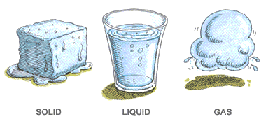
True (Solid, liquid and gas)

Slide 3
Question of the day
Does water regulate the earth’s temperature?
Correct?

Slide 4
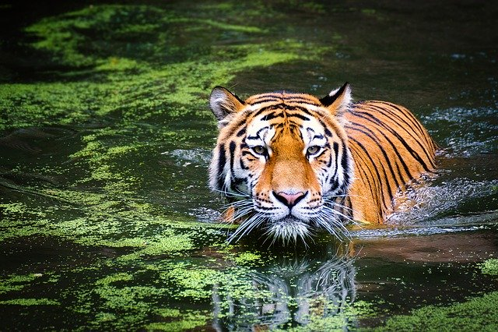
Yes, it is a natural insulator.

Slide 5
Question of the day
How much of the human body is water?
How much of the earth’s surface is water?
Can you guess?

Slide 6
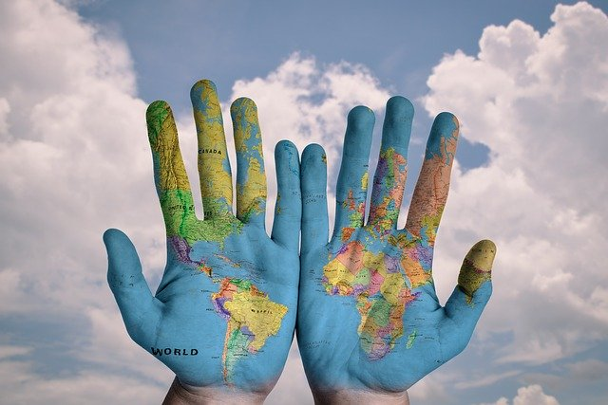
66% of the human body is water.
80% of the earth’s surface is water.

Slide 7
Question of the day
How much of the earth’s water is suitable for drinking

Slide 8
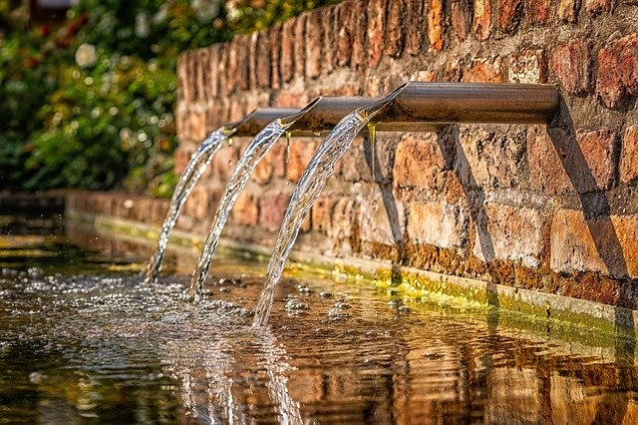
1%
Freshwater makes up a very small fraction of all water on the planet. While nearly 70 percent of the world is covered by water, only 2.5 percent of it is fresh. The rest is saline and ocean-based. Even then, just 1 percent of our freshwater is easily accessible, with much of it trapped in glaciers and snowfields.

Slide 9

Question of the day
Is it possible for me to drink water that was part of the dinosaur

Slide 10
Correct answer: yes
Water is constantly recycled.

Slide 11
Question of the day
How much water is used in the average five-minute shower?

Slide 12
The U.S. Environmental Protection Agency estimates that the standard shower heads use 2.5 gallons (9.5 liters) of water per minute.
That's 20 gallons (76 liters) of water for the average shower!

Slide 13
Question of the day
On the average, how much is used to hand wash dishes?

Slide 14
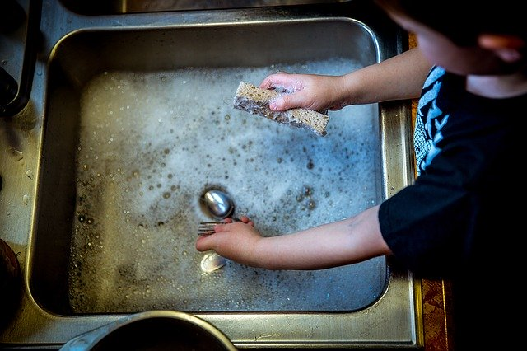
9-20 gallons

Slide 15
Question of the day
How much of their water do people typically get from food?

Slide 16
Correct answer: 20%
The average person gets about 20% of their water for the day from food. An apple is 65% water. Bananas are 70% water. Broccoli is about 90% water. Even foods that you might not think of as moist -- a slice of white bread (40% water), ground beef (53%), American cheese (28%) -- help.

Slide 17
Question of the day
The amount of fluid you need to stay properly hydrated depends on:
a. Your age
b. Your health
c. The weather
d. All of the above

Slide 18
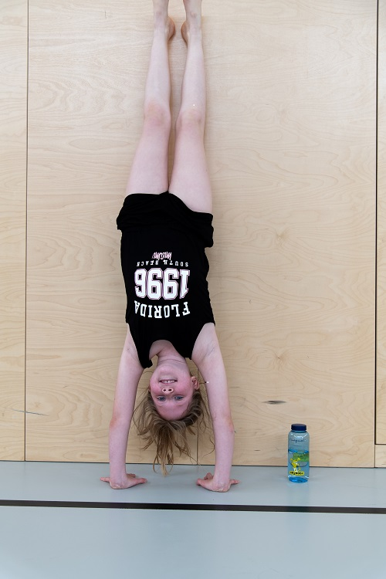
Correct answer: d
How much fluid you need depends upon several things, including:
Age: Kids need plenty of fluids; they can get dehydrated much more easily than adults. Older people may need more fluids because of health conditions or because they tend to lose their sense of thirst.
Gender: Men need more fluids than women. (And pregnant women need more fluids than other women.)
Weight: Heavier people need more water.
Health: Conditions such as diabetes, cystic fibrosis, and kidney disease can boost your need for fluids.
Environment: You need more fluids in extreme weather conditions (especially hot, humid, or cold) and at high altitudes.

